Slide 1


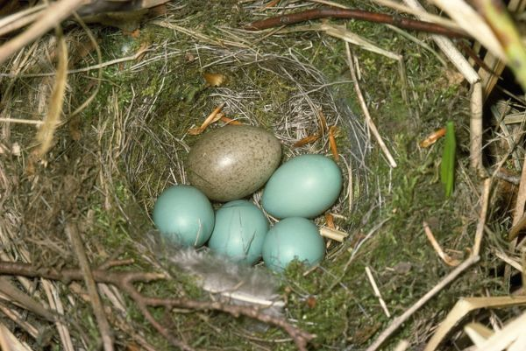
Application of Cuckoo Search Algorithm to solve a Continuous Optimization Problem
Kalpana Shankhwar
D06522022
Department of Mechanical Engineering
To
Prof. Feng-Cheng Yang
Department of Graduate Institute of Industrial Engineering
National Taiwan University
Date: 24/12/2018

Slide 2
Content
Introduction
Methodology
Results and Discussions
Conclusions
Future work

Slide 3
INTRODUCTION
In this work, the solver for Cuckoo search and PSO algorithm was designed and developed and implemented in C#.
The algorithms were tested on COP.benchmark files with single objective problems with lower dimensions (2 design variables) and higher dimensions (30 design variables).

Slide 4
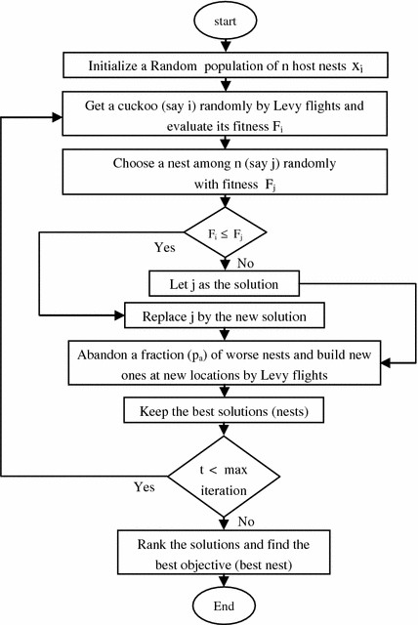
Methodology
Flow Chart of the Cuckoo search
The important parameters are sigma and step size for iteration of new solutions (bird nests). These are calculated through formulaes (Levy flights) [1].
Advantage of having fewer parameters [2].
[1] Gandomi, Amir Hossein, Xin-She Yang, and Amir Hossein Alavi. "Cuckoo search algorithm: a metaheuristic approach to solve structural optimization problems." Engineering with computers 29.1 (2013): 17-35.
[2] Yang, Xin-She, and Suash Deb. "Cuckoo search via Lévy flights." Nature & Biologically Inspired Computing, 2009. NaBIC 2009. World Congress on. IEEE, 2009. 2.

Slide 5
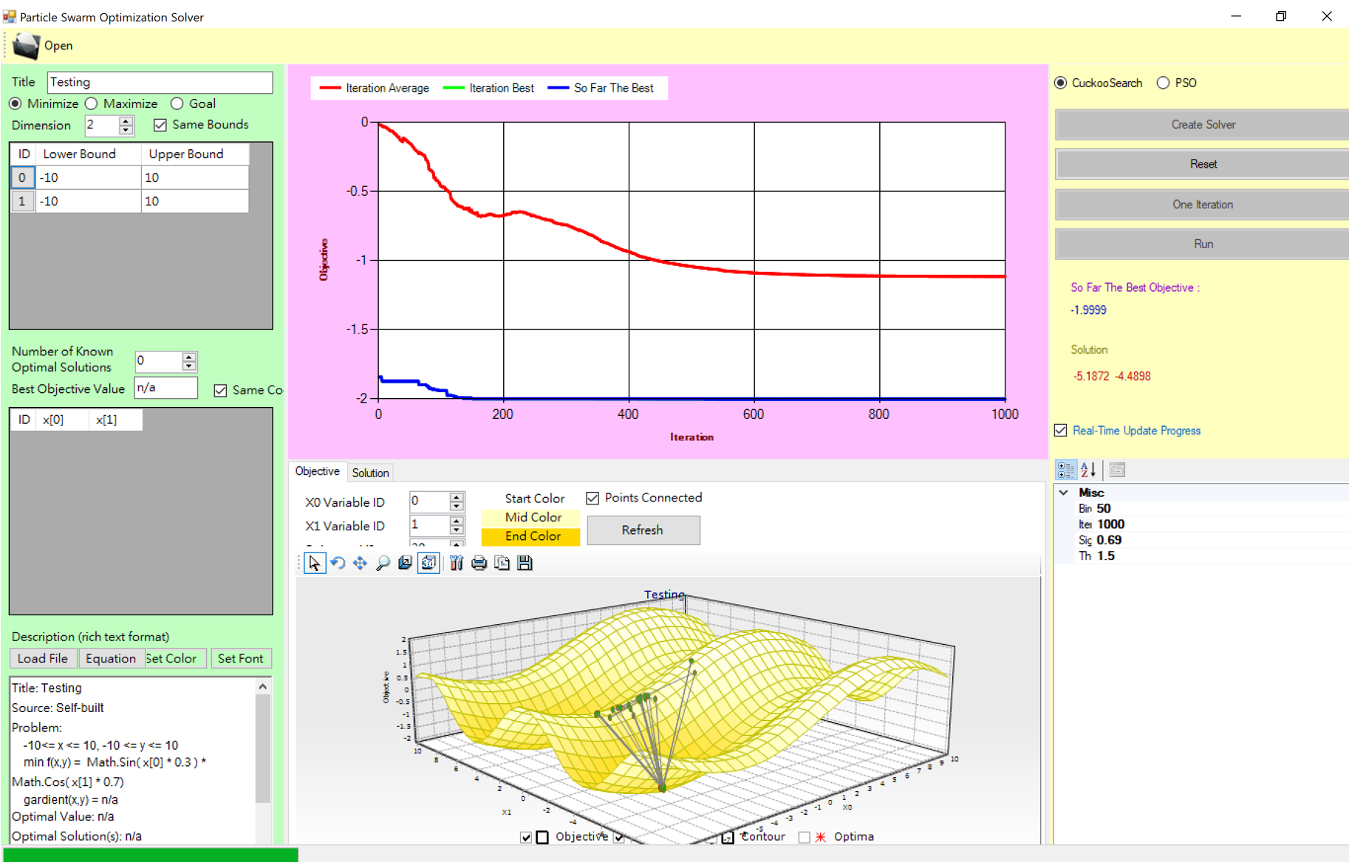
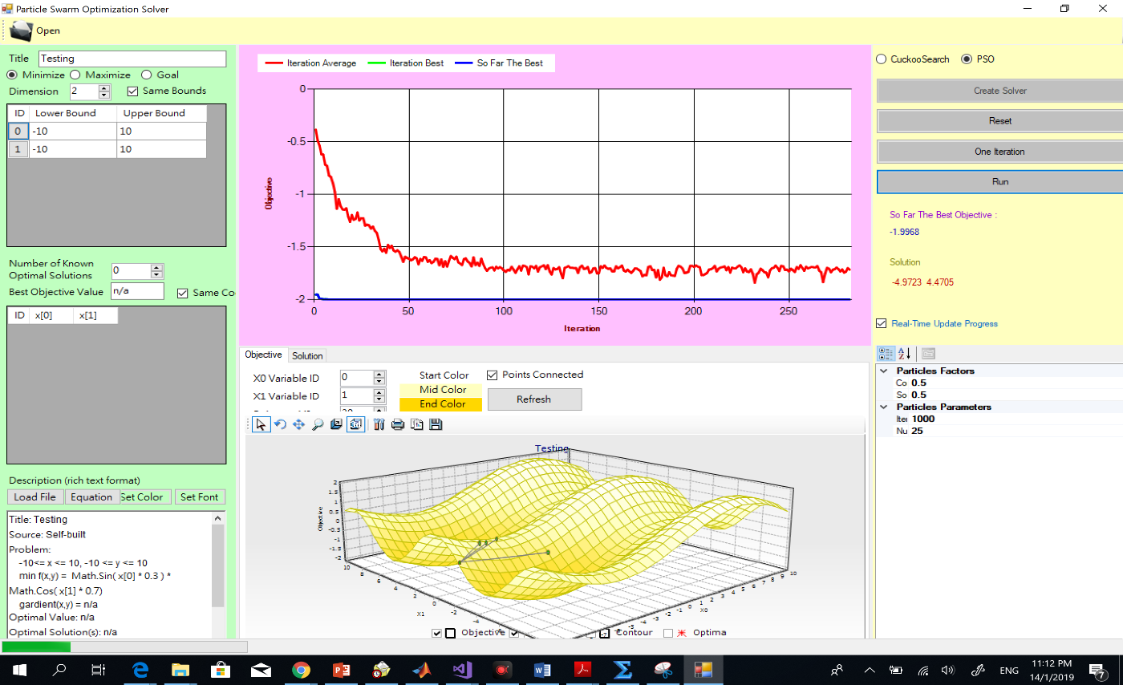
Results
Testing.cop problem (2 dimensions)
PSO
Cuckoo search

Slide 6
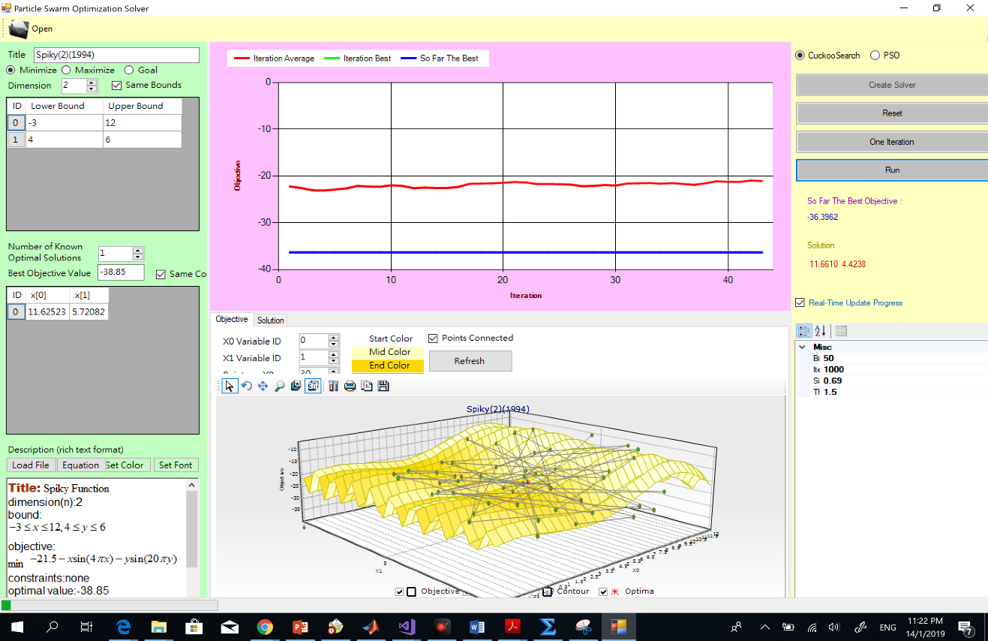

Results
Spiky function problem (2 dimensions)
PSO
Cuckoo search

Slide 7
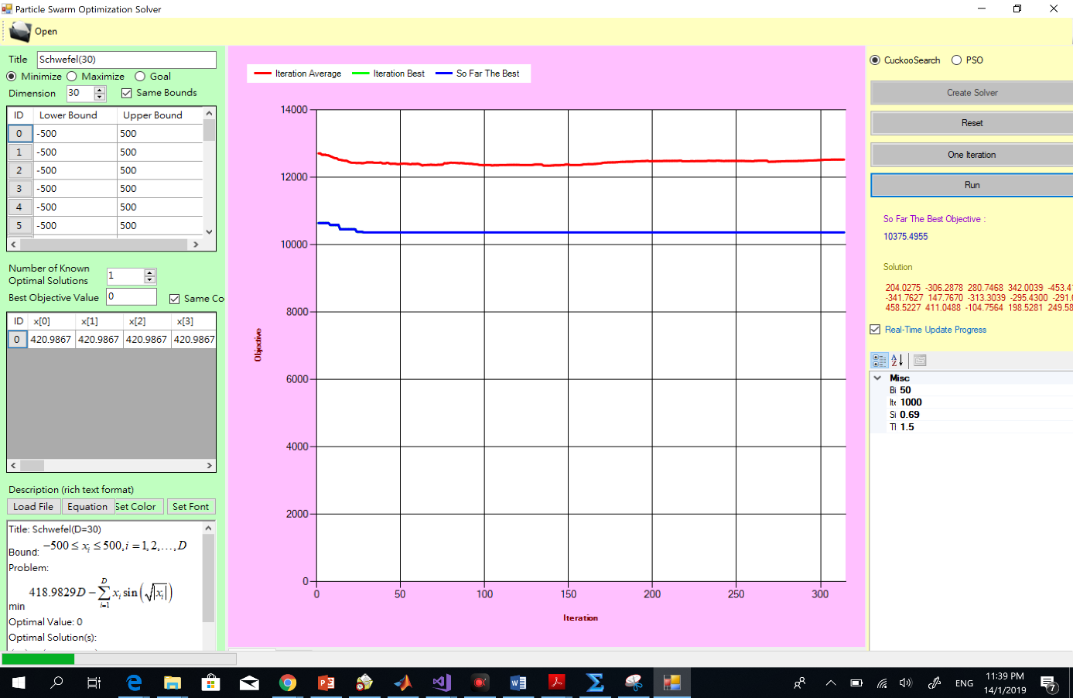
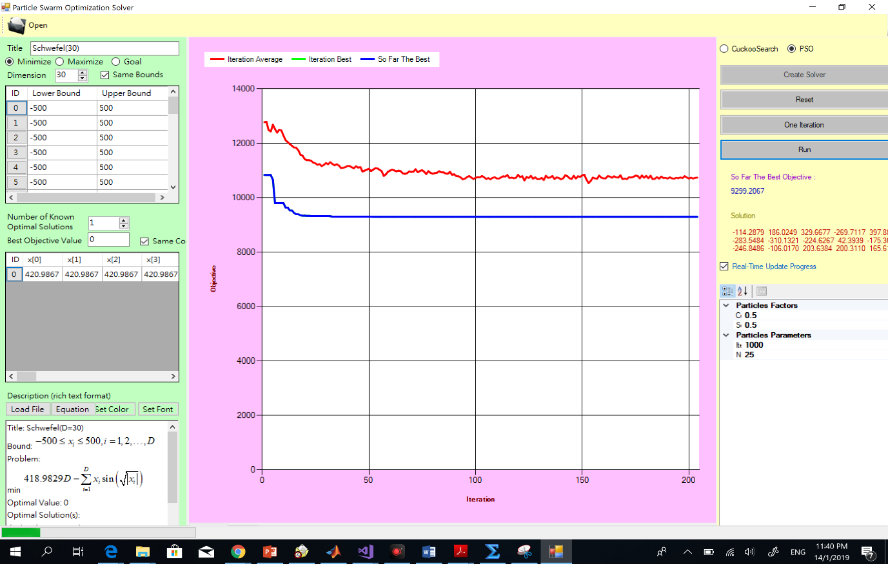
Results
Schwefel(D=30) problem (30 dimensions)
PSO
Cuckoo search

Slide 8
Summary of results
Single objective Problem |  | Solutions (final Fitness, {optimum decision variables values}, Iteration)
Name | Dimensions | Cuckoo search | PSO
Testing.cop | 2 | (-1.99, {-5.18, -4.49}, 600) | (-1.99, {-4.97, -4.47}, 100)
Spiky Function | 2 | (-36.392, {11.66, 4.42}) | (-35.31,{10.66,4.82})
Schwefel(D=30) | 30 | ( 10375.49) | (9299.20)
Table 1: Optimization problems, solver and solutions

Slide 9
Conclusions and findings
The main findings are as follows:
The results of both the algorithms are somewhat comparable in all three problems. However, considering the iteration factor(time), PSO has performed better than cuckoo search, achieving the earlier convergence.
For third problem with higher dimensions having 30 variables, both the algorithms perform poorly achieving lower convergence and maximum deviation from the optimal solution. This shows the case of local minima.
In case of cuckoo search, the evolutionary search guidance process (global search) has performed poorer. Besides, there is also a possibility that the population (bird nests) generated at every iteration were having solutions with lower diversity (worst cases are found more than the good ones). Thus, this has resulted in slower convergence of cuckoo search.

Slide 10
Future work
(a) For cuckoo search, an improved guiding search mechanism for generation of new bird nest at every iteration needs to be developed.
(b) The new discovery mechanisms (may be used in other evolutionary algorithms) need to be incorporated in cuckoo search and investigated for problems with higher dimensions (30 variables (real problems)) and constrained optimization. This is so as to prevent the algorithm in getting converged at local minima and maintaining higher diversity of solutions.

Slide 11
Thankyou for your attention!

Slide 12
New solution generation for a Cuckoo i,
Levy’s distribution is given by
Where step size α > 0

